Slide 1

NYC YELLOW TAXI
GROUP 9
JEGAN NADAR
MANIHAS SINGIREDDY

Slide 2
INTRODUCTION
PROBLEM DEFINITION
HYPOTHESIS
DATASET USED
EDA
CONCLUSION
01
02
CONTENT
03
04
05
06

Slide 3
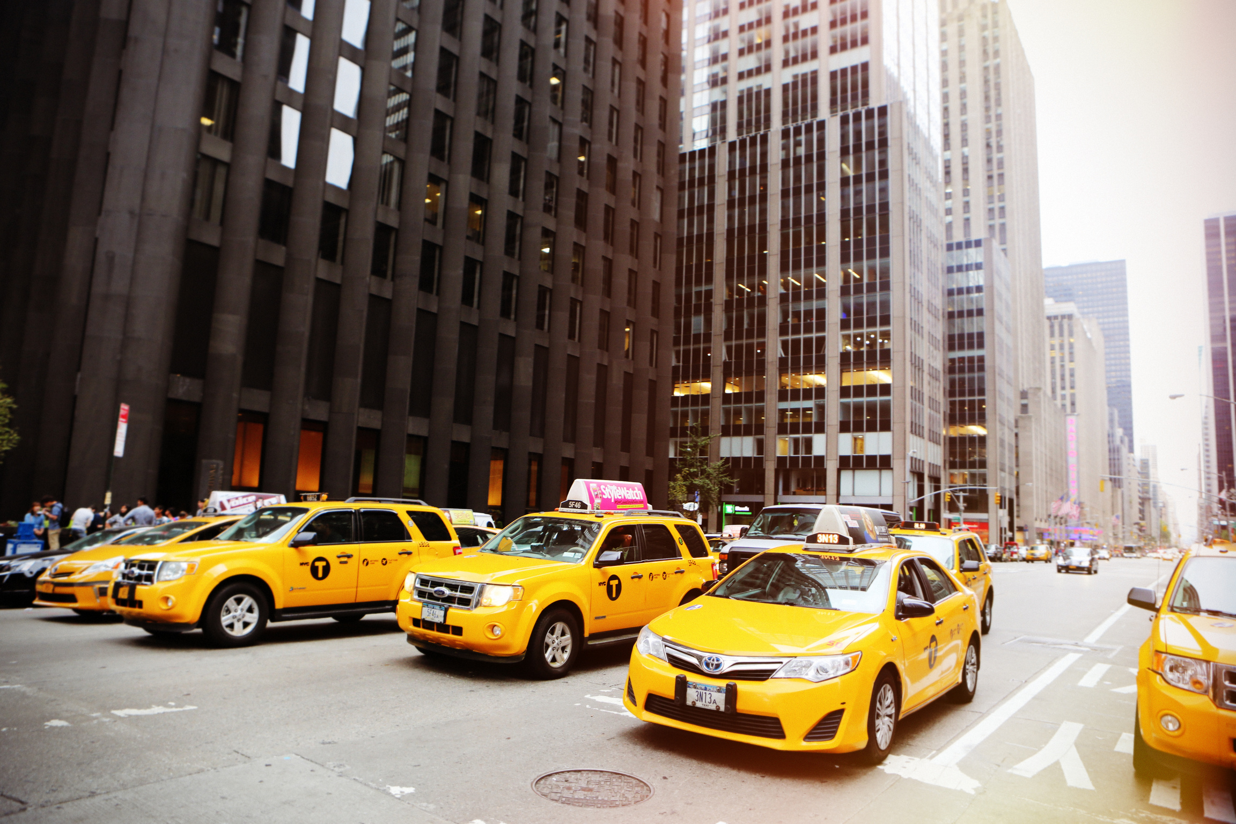
INTRODUCTION
Welcome to the captivating world of New York City's taxi rides. Through meticulous analysis of the NYC Taxi Dataset, we unravel the intricate patterns and behaviors that define the pulse of the city's transportation network. Join us as we navigate through the data-driven landscape of one of the world's busiest metropolises..

Slide 4
PROBLEM DEFINITION
In this project, our goal is to harness the power of data to address critical challenges and optimize the efficiency of New York City's taxi services. By leveraging the insights gleaned from the NYC Taxi Dataset, we aim to identify key factors influencing ride duration, improve route planning, and analyze the total fare of the ride and we compare yellow taxi with for hire taxi to understand how market is about. Join us as we tackle real-world transportation issues head-on through data-driven analysis and innovation.

Slide 5
HYPOTHESIS
Based on preliminary analysis of the NYC Taxi Dataset, we hypothesize that certain factors such as pickup location, time of day, day of the week, and weather conditions may significantly influence taxi trip durations. By leveraging advanced data analytics techniques, we aim to uncover hidden patterns within the data and develop predictive models that accurately estimate taxi revenue. This analysis will not only enhance our understanding of taxi service dynamics in New York City but also provide valuable insights for optimizing taxi operations and improving overall service efficiency.

Slide 6
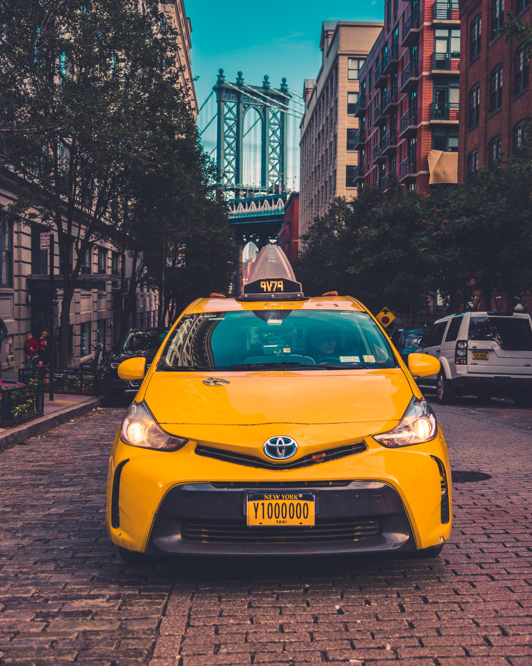

DATASET USED
YELLOW TAXI DATA
FHV (FOR-HIRE VEHICLE) DATA
This data represents the information of cabs that run in New York City (2020)
This data stores the information of vehicles that are hired by citizens using mobile apps (2020)

Slide 7
DATASET USED
TAXI DATA
Our analysis harnesses the power of the NYC Taxi Dataset, a comprehensive collection of taxi ride records capturing the essence of New York City's bustling streets. This rich dataset includes essential features such as pickup and drop-off timestamps, passenger count, trip distance, fare amount, total amount, as well as details on the pickup and drop-off locations categorized by boroughs and zones. Leveraging these meticulously curated data points, we aim to gain profound insights into ride durations, spatial patterns, and factors influencing taxi services in the city. Join us as we unlock the potential of this invaluable dataset to revolutionize transportation analysis.

Slide 8
DATASET USED
FHV (FOR-HIRE VEHICLES) DATA
Our analysis is fueled by the For-Hire Vehicles Dataset, a comprehensive collection of ride records capturing the dynamic landscape of transportation services in our target area. This dataset encompasses vital features such as pickup and drop-off timestamps, location IDs, trip distance, trip duration, and base passenger fares. Leveraging these key attributes, we endeavor to unravel the intricacies of for-hire vehicle operations, optimize route planning, and enhance overall service efficiency. Join us as we delve into the wealth of insights embedded within this invaluable dataset.

Slide 9
DATASET USED
TAXI ZONE DATA
Our analysis incorporates the Taxi Zone Data, providing essential information on the geographic zones within our study area. This dataset includes key attributes such as LocationID, Borough, Zone, and service zone classifications. By leveraging this geographical reference data, we aim to enhance spatial analysis, visualize taxi service coverage areas, and enrich our understanding of the transportation landscape. Join us as we utilize this foundational dataset to contextualize and augment our analysis of taxi services in the region.

Slide 10
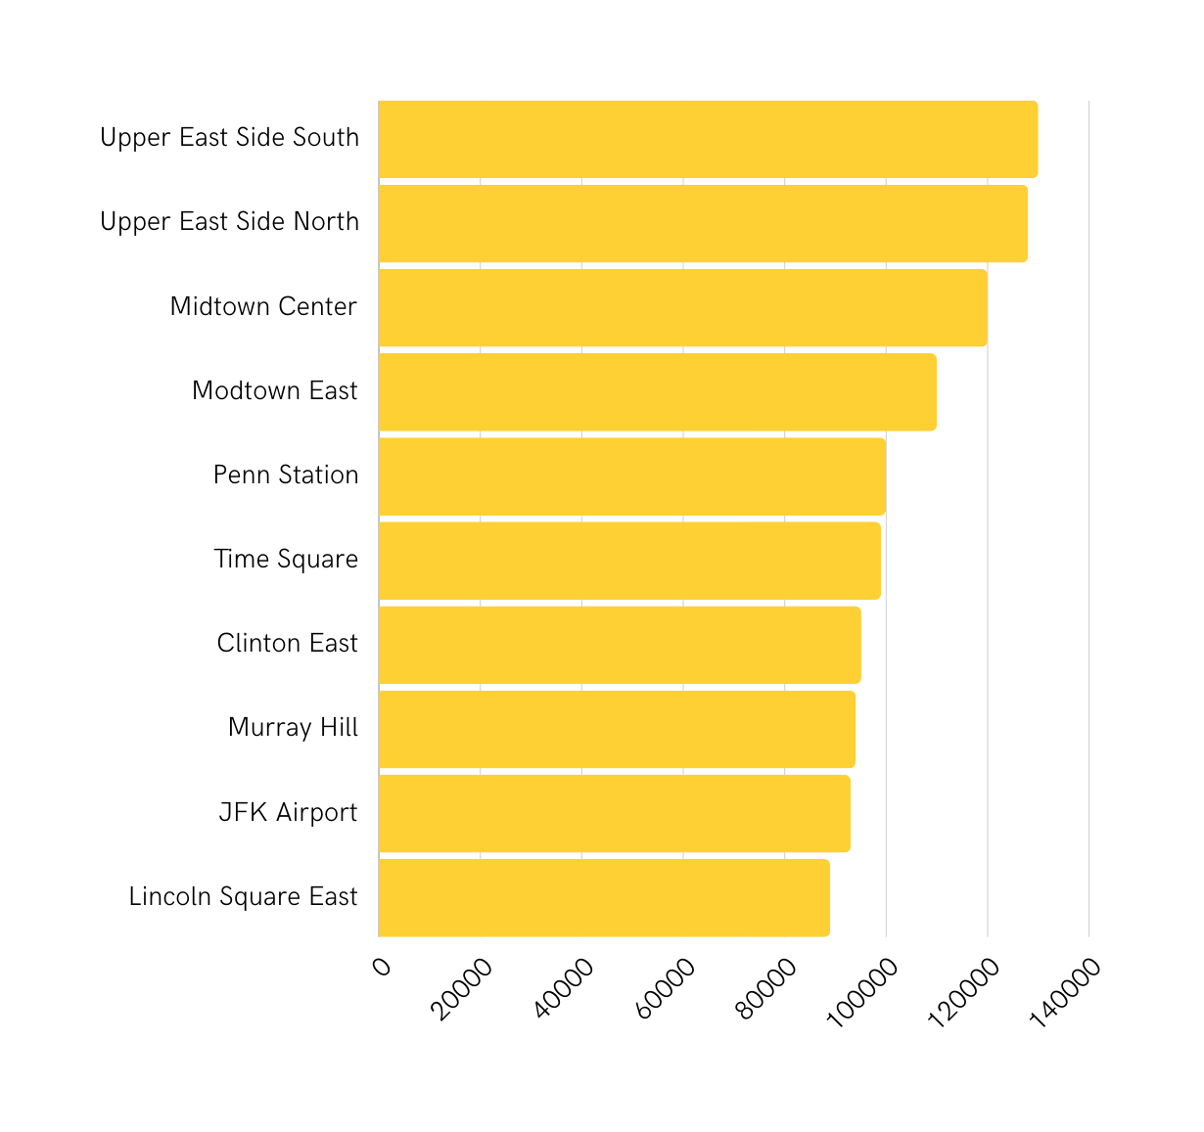
EDA
Pick up zones
Top 10 Pickup Zones for Taxi Data
Number of Pickups

Slide 11
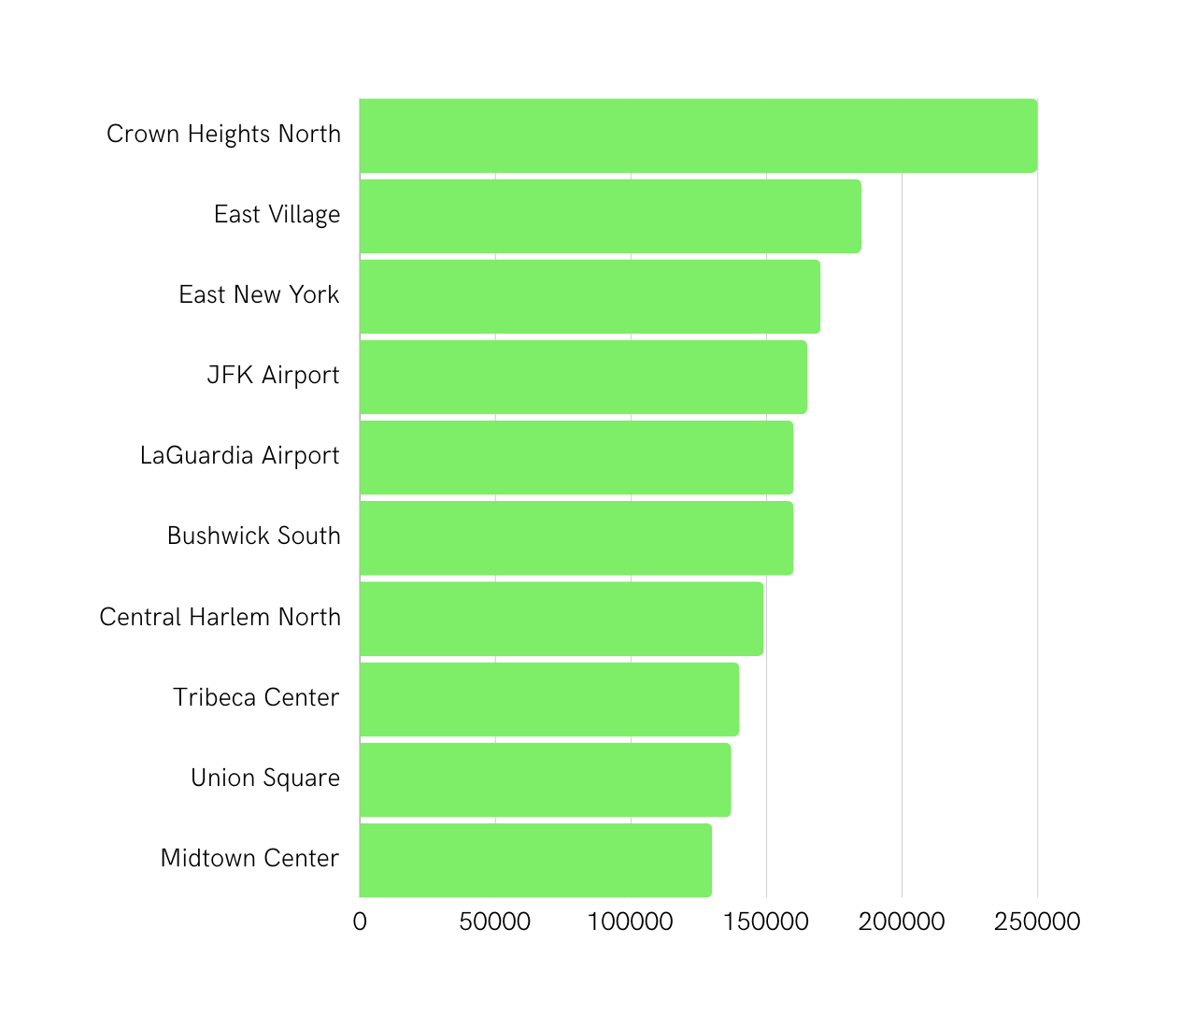
EDA
Pick up zones
Top 10 Pickup Zones for FHV Data
Number of Pickups

Slide 12
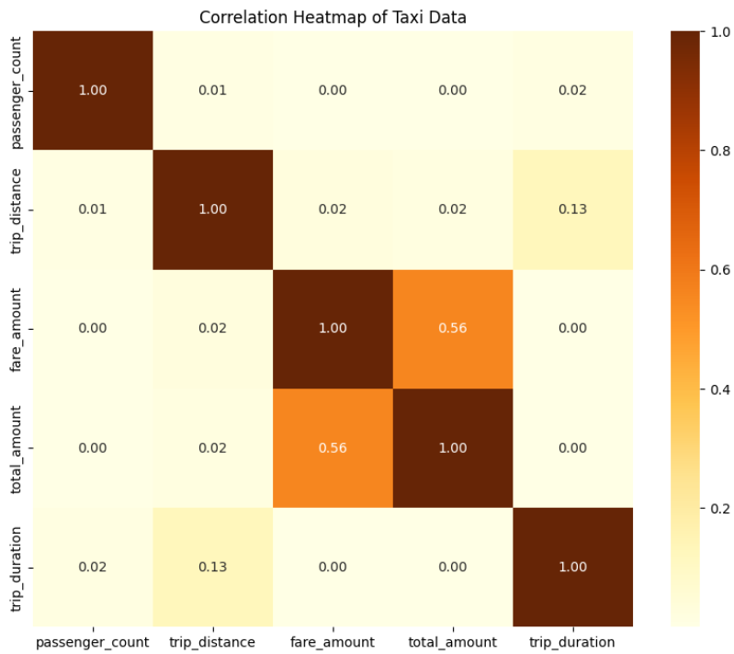
EDA
Correlation Heatmap of Taxi Data

Slide 13
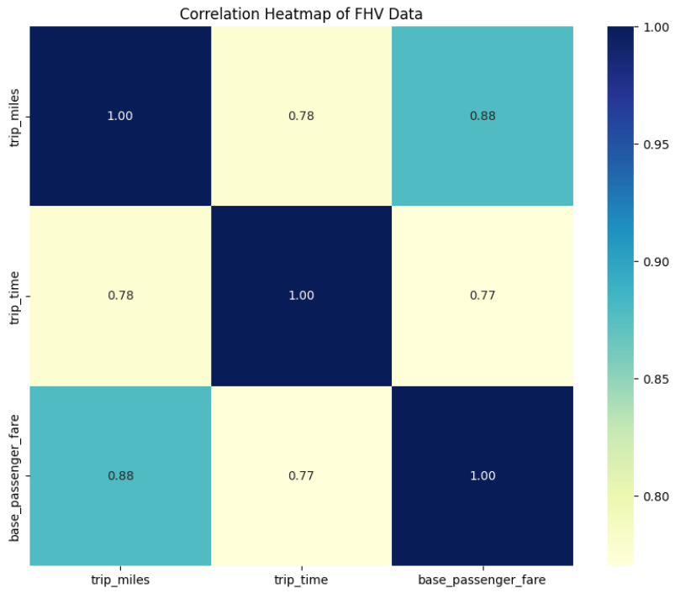
EDA
Correlation Heatmap of FHV Data

Slide 14
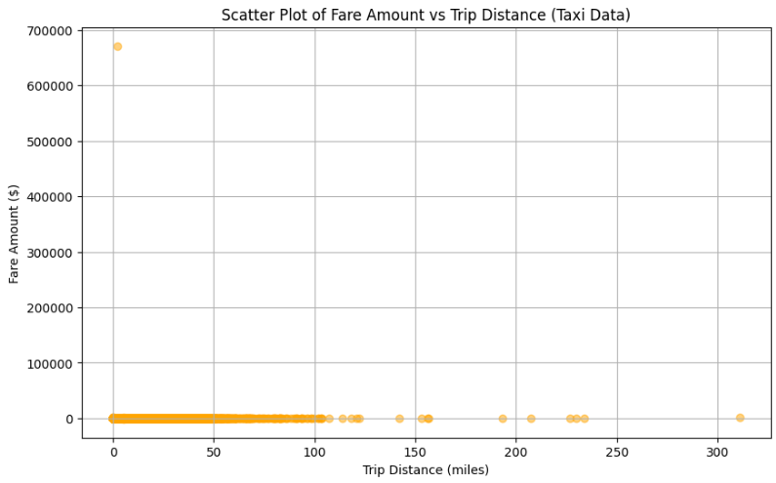
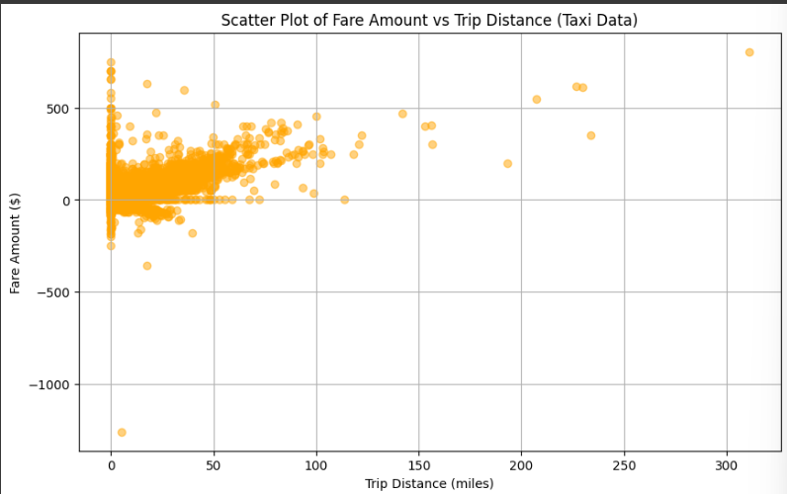
EDA
Scatter Plot of Taxi Data
(Error)

Slide 15
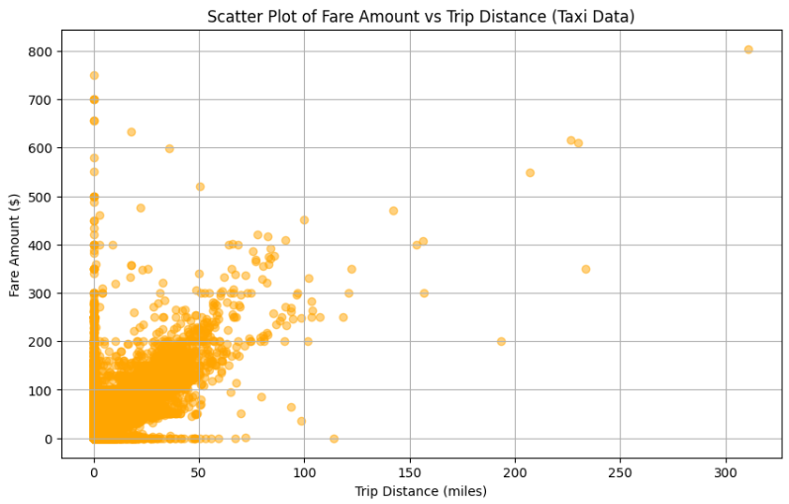
EDA
Scatter Plot of Taxi Data
(After Correction)

Slide 16
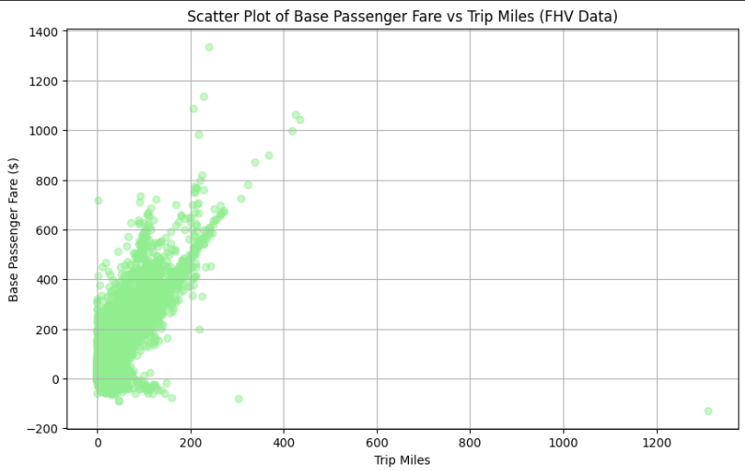
EDA
Scatter Plot of FHV Data
(Error)

Slide 17
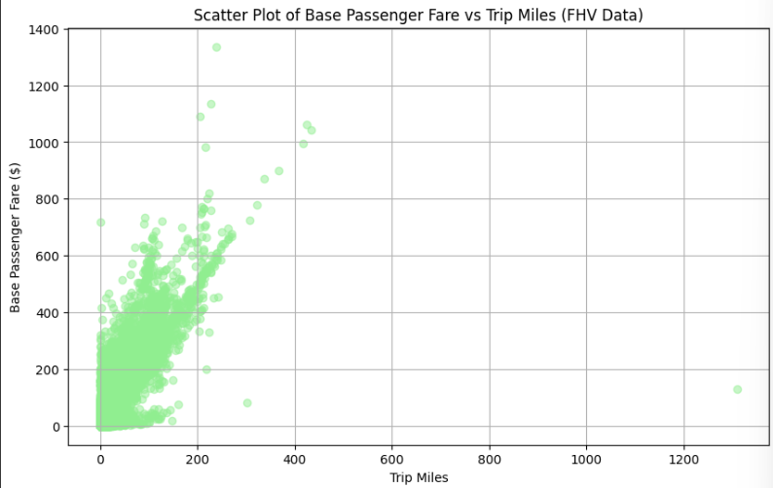
EDA
Scatter Plot of FHV Data
(After Correction)

Slide 18
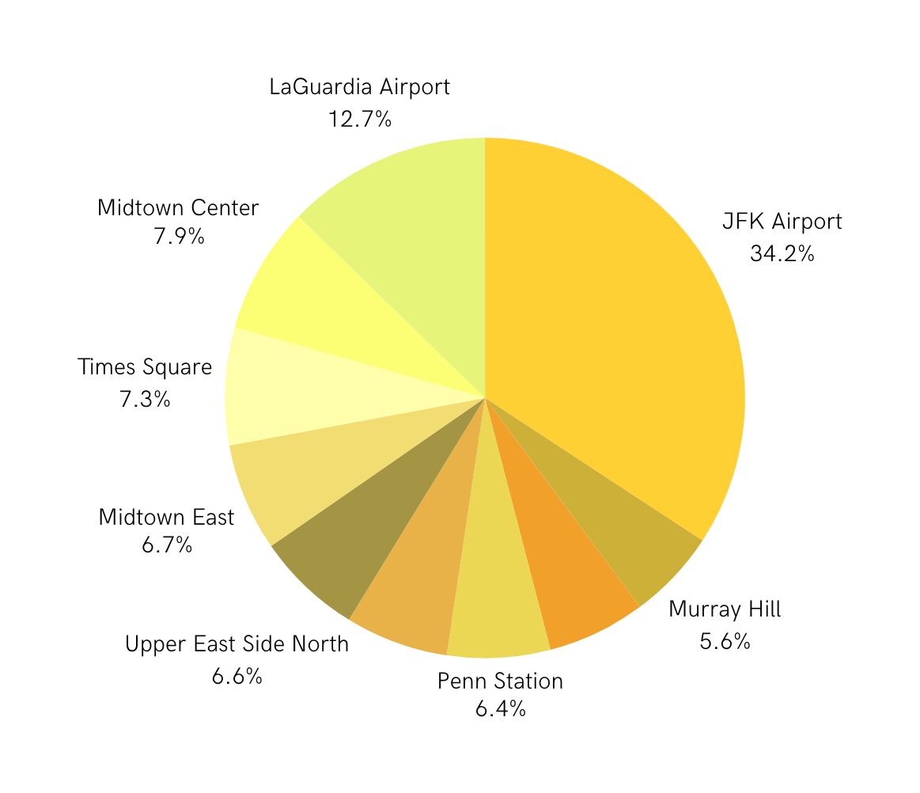
EDA
Top Ten Pickup Locations by Trip Distance of Taxi Data

Slide 19
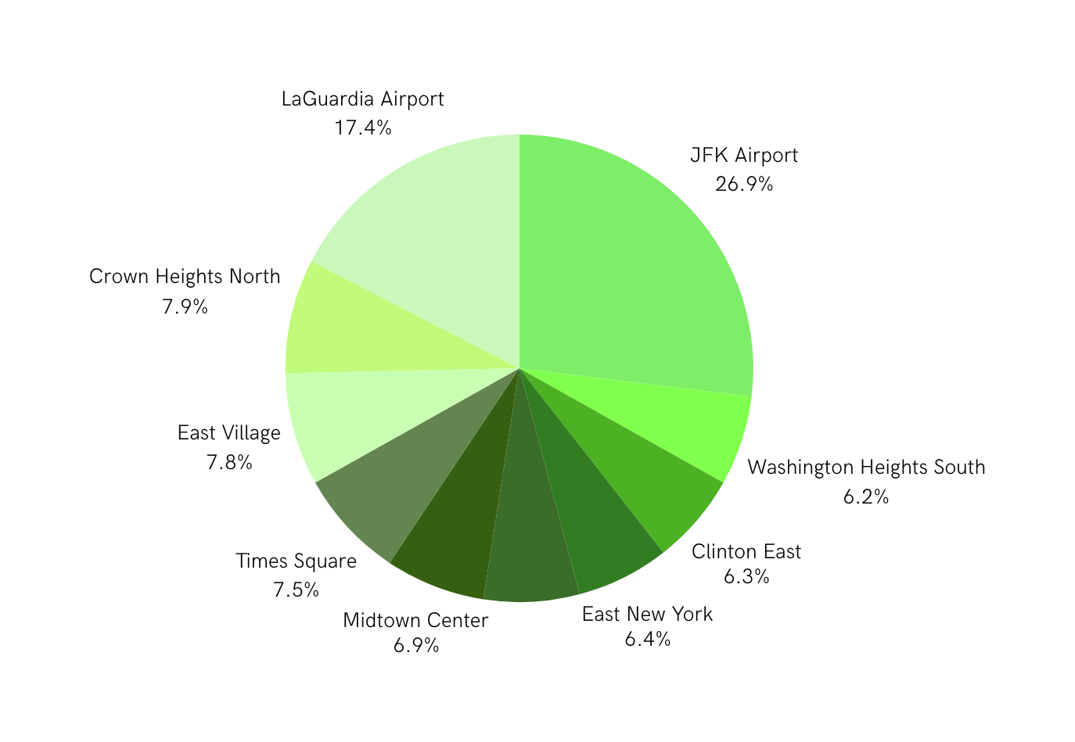
EDA
Top Ten Pickup Locations by Trip Distance of FHV Data

Slide 20
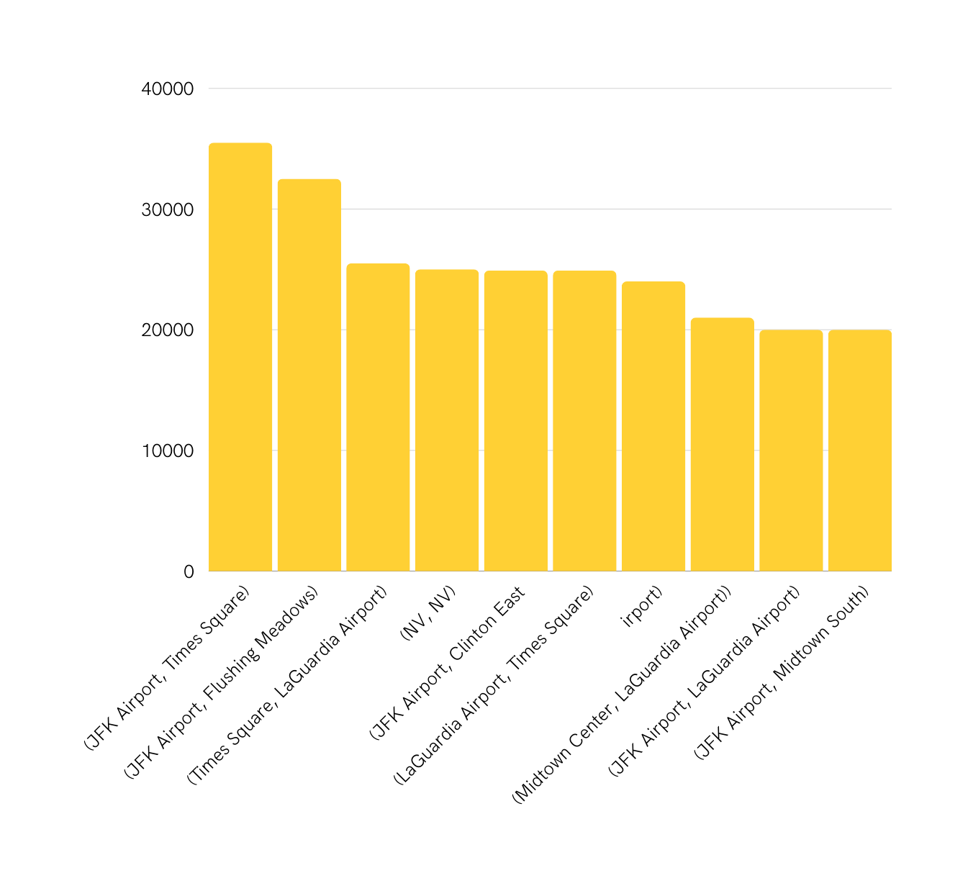
Total Trip Distance
EDA
Top 10 Pickup Zones for Taxi Data

Slide 21
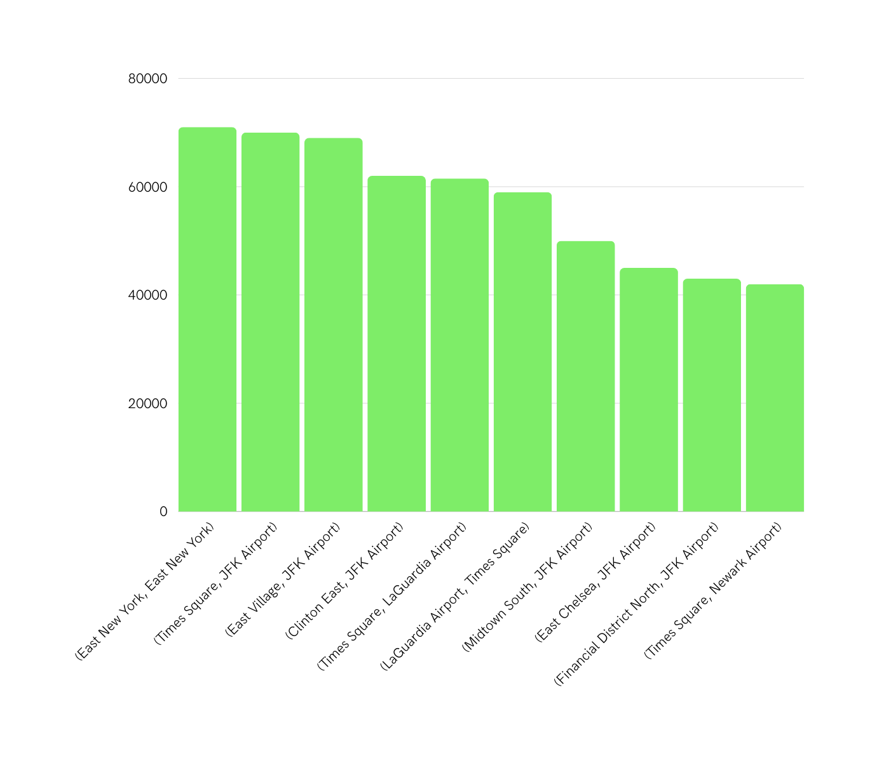
Total Trip Distance
EDA
Top 10 Pickup Zones for FHV Data

Slide 22
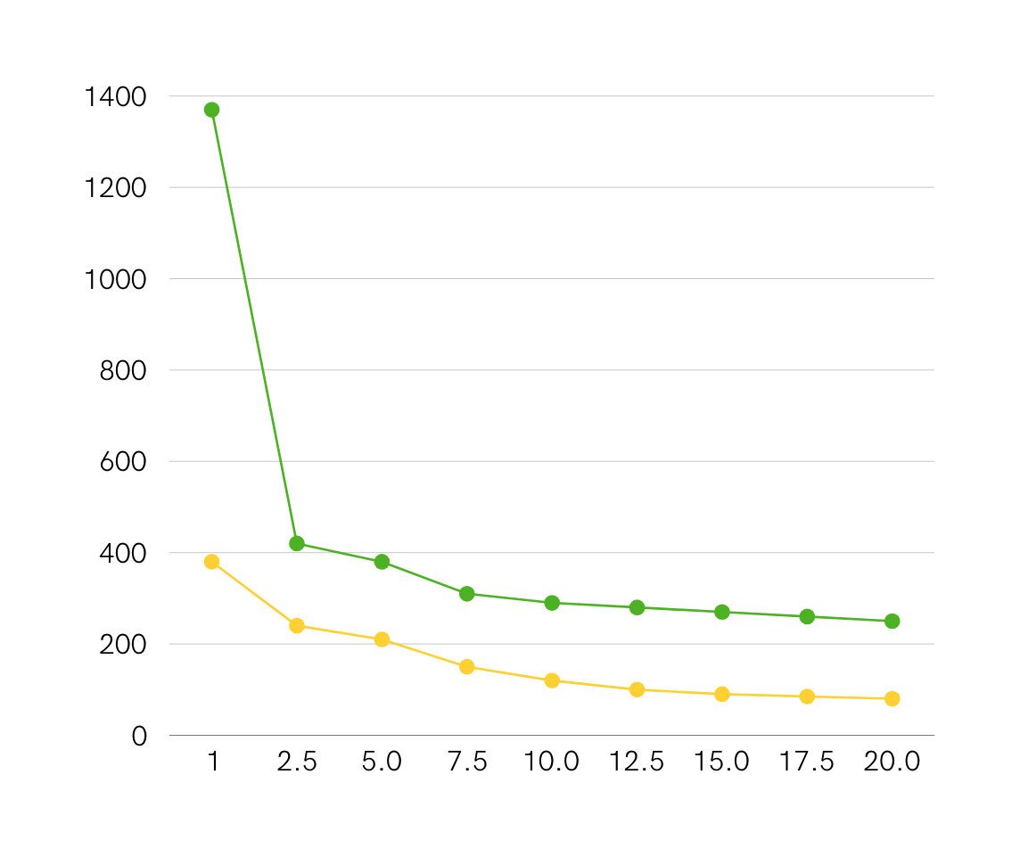
Top 20 Trip Distances Comparison Between FHV & Taxi Data
Trip Distance
Trip Index

Slide 23
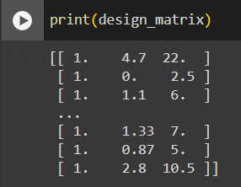
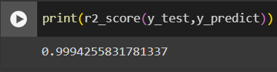
LINEAR REGRESSION MODEL
Using the Linear Regression Model, we have predicted that the Total Revenue for Yellow Taxi can be raised when the Fare Amount, Trip Distance & Trip Duration is considered for the change.

Slide 24
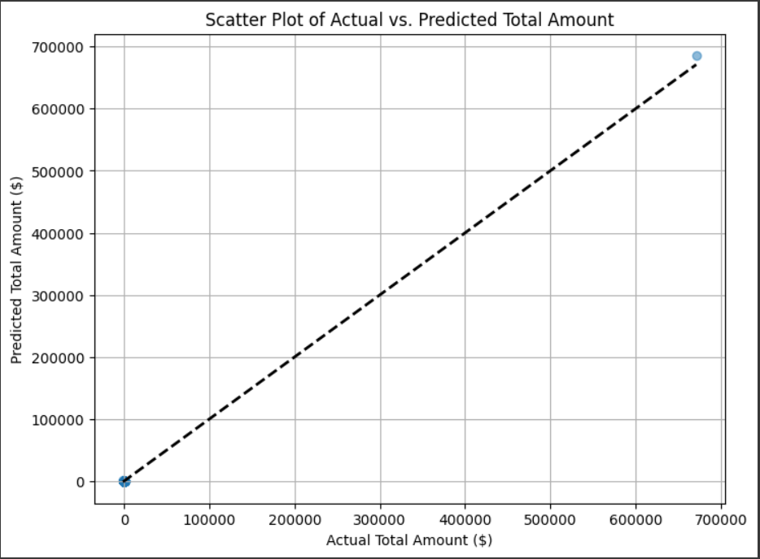
LINEAR REGRESSION MODEL
Basic Representation of Actual Total Amount VS Predicted Total Amount

Slide 25

CONCLUSION
In conclusion, our analysis of the NYC Taxi Dataset, using Scikit-learn, has yielded valuable insights into the factors influencing taxi trip durations in New York City. Through Linear regression modeling, we have identified significant relationships between various features such as pickup location, time of day, and trip distance with trip durations. Our predictive models, developed with Scikit-learn's algorithms, have shown promising accuracy in estimating taxi ride durations. These findings underscore the effectiveness of Scikit-learn in extracting meaningful patterns from complex datasets and provide actionable insights for optimizing taxi operations and improving service efficiency in urban environments.

Slide 26

Thank you!
For your precious time :)

